Slide 1
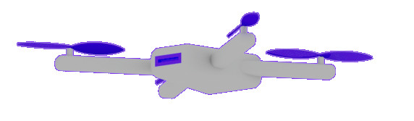

Welcome to
.NET Conf 2022!
Gaurav Seth @gauravseth
Scott Hunter @coolcsh

Slide 2
















Build anything with a unified platform
CLOUD
WEB
DESKTOP
MOBILE
GAMING
IoT
AI
.NET
+
+
Visual Studio
Family
Visual Studio Code
CLI
Linux
NuGet
GitHub
Components, tools, library vendors
Windows
macOS
TOOLS
OPERATING SYSTEM
ECOSYSTEM

Slide 3


.NET 6 adoption
Ecosystem
#1
Active users by version
(month since release)
+1.8x
>5.7M total
Most Loved Developer Framework (2019-2022)
.NET Core/.NET
Top 5
Top 5
Language on GitHub
C#
Highest velocity OSS project
github.com/dotnet
Sources: survey.stackoverflow.co/2022/#section-most-loved-dreaded-and-wanted-other-frameworks-and-libraries ; github.com/cncf/velocity/blob/master/reports/top_projects_by_activity.txt; octoverse.github.com/;

Slide 4
.NET Open Source Community
>48,000
COMMUNITY MEMBERS HAVE CONTRIBUTED TO .NET

Slide 5
NuGet
NEW FEATURES
Over 240,000,000 package downloads
Central Package Management
Over 329,000 packages
Transitive Dependencies
Two Factor
Authentication
Source Mapping

Slide 6


Thank You!

Slide 7
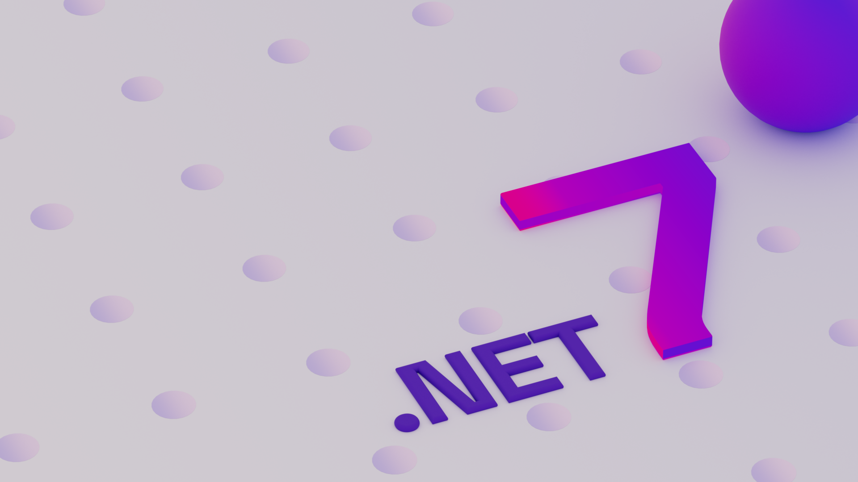
Announcing .NET 7
>28k
>10K
CONTRIBUTIONS
COMMUNITY MEMBERS

Slide 8

“Organizations in every industry are turning to developers to help them do more with less. Less time, less cost, less complexity, more innovation, more agility, more resilience.”
Satya Nadella, Ignite 2022

Slide 9
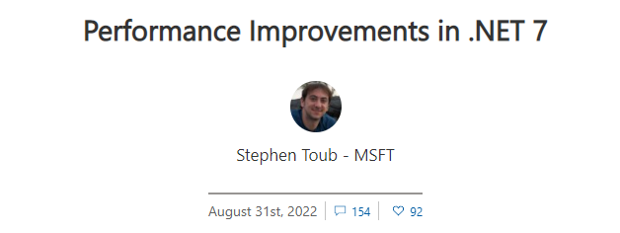
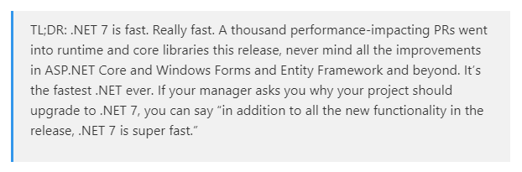
Performance Improvements in every release
Performance-related improvements
.NET 5
250+
.NET 6
550+
.NET 7
1000+
Learn more
|
Session 08:30am PT tomorrow by Stephen Toub

Slide 10
.NET 7 Highlights
Native support for ARM64
Enhanced .NET support on Linux
Unified
Build cross-platform mobile & desktop apps from same codebase
Improvements to API performance
Easy to build & deploy distributed cloud native apps
Modern
Simplify and write less code with C#11
HTTP/3 and minimal APIs improvements for cloud native apps
Simple
Productive
Dev Tunnels to easily develop and debug cloud API integrations
Configure, Build, Publish containers via .NET SDK - CLI and VS (coming soon)
get.dot.net/7

Slide 11
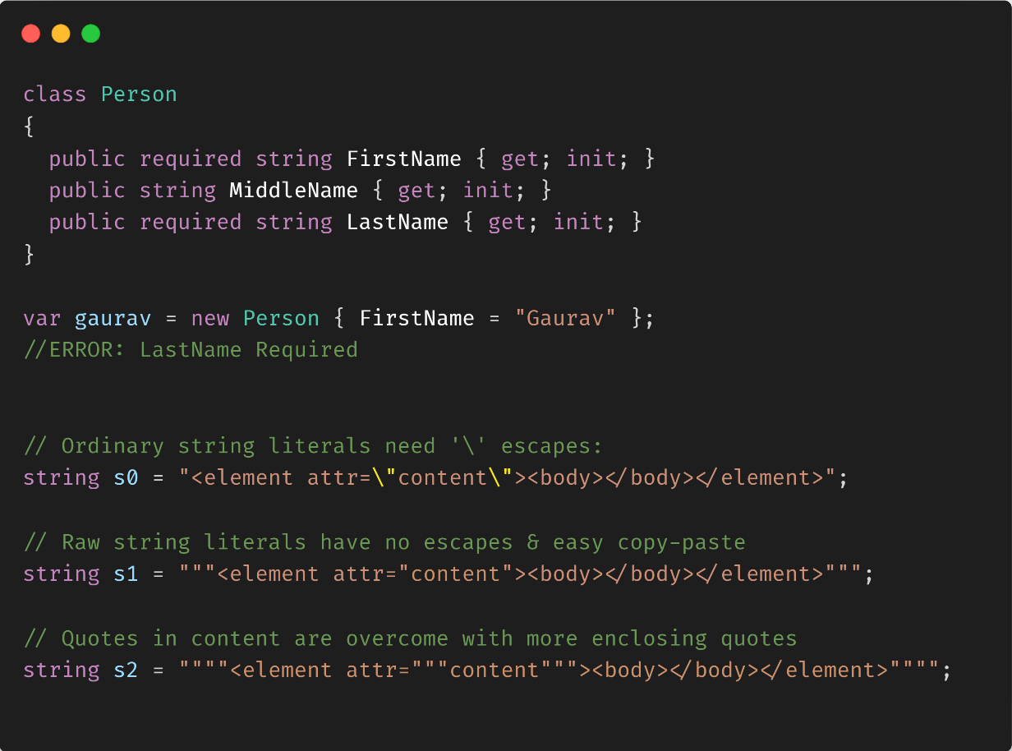
Simplify your code with C# 11
Syntactic simplifications, less boilerplate
Generic math support
List patterns
Required members
Raw string literals
General availability in .NET 7

Slide 12




.NET 7 is the best for modern apps
Web
Cloud
Client

Slide 13

Modern web with .NET
Runtime
APIs
Web UI
HTTP/3 & Faster HTTP/2 uploads
ARM64 support for Kestrel & IIS
Rate Limiting
Output caching
Auth Improvements with JWT
Route grouping
Enhanced OpenAPI support
gRPC JSON transcoding
Blazor custom elements
Data binding get/set/after modifiers
WebAssembly SIMD
Experimental QuickGrid
Learn more
|
State of ASP.NET Core – 9:00 AM Pacific

Slide 14














APIs are everywhere
.NET
APIs

Slide 15
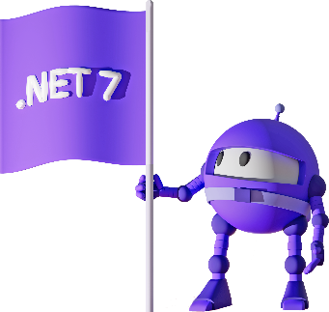
.NET 7 Performance – APIs
Requests Per Second (Millions)
2.20M
0.60M
7.02M
Node.js
Java Servlet
ASP.NET Core
ASP.NET CORE WEB FRAMEWORK IS
>11X
FASTER THAN NODE.JS
Source: https://www.techempower.com/benchmarks/#section=data-r21&hw=ph&test=plaintext

Slide 16
.NET 7 Performance - API
Continuous focus on improvement:
Plaintext: 8% more RPS
JSON: 16% more RPS
Fortunes: 25% more RPS
Tech Empower JSON
+16%
Source: https://www.techempower.com/benchmarks/#section=data-r21&hw=ph&test=json

Slide 17
.NET Data and Entity Framework Core New Features in .NET 7
Distributed transactions
Mapping to JSON columns for SQL
SaveChanges performance and bulk updates
Custom reverse engineering templates
Stored procedures for insert/update/delete
Time to insert multiple rows milliseconds (lower is better)
4x faster
4 Rows - SaveChangesAsync
Source: https://devblogs.microsoft.com/dotnet/announcing-ef-core-7-preview6-performance-optimizations/

Slide 18
gRPC
High performance cross-platform contract-first cloud native APIs
Requests Per Second (Higher is Better)
99.8K
96.1K
89.4K
72.5K
68.9K
Java
Go
C++
Rust
.NET 7
Source: https://github.com/LesnyRumcajs/grpc_bench/wiki

Slide 19
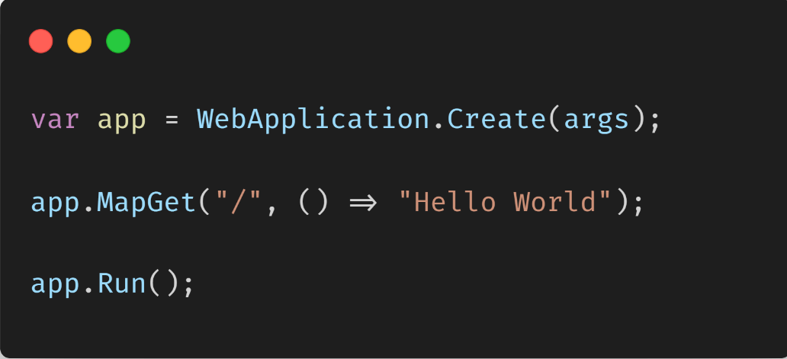
.NET REST APIs – Minimal
Lightweight, single-file, cloud native APIs
Low ceremony, top-level C# programs
Easy to get started
Scale to any app size

Slide 20
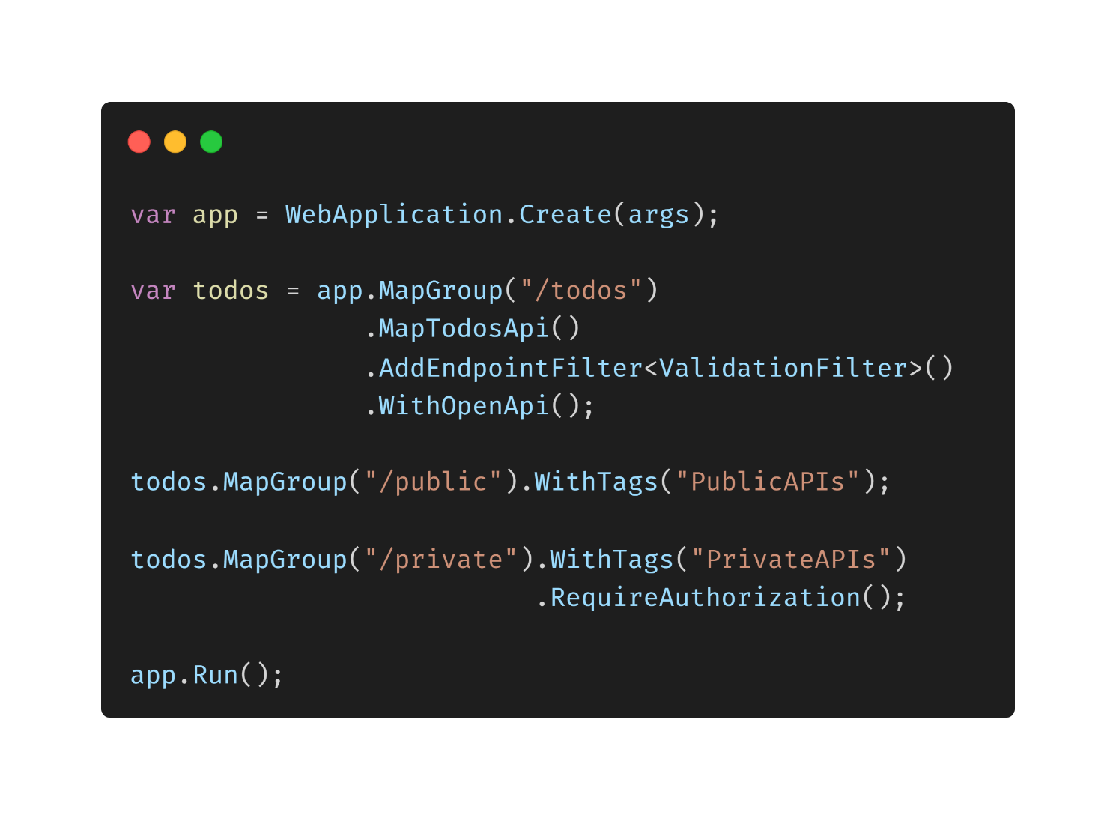
.NET REST APIs – Powerful
Organize groups of endpoints
Leverage endpoint filters for validation, logging, and much more
Improved testing and OpenAPI docs

Slide 21
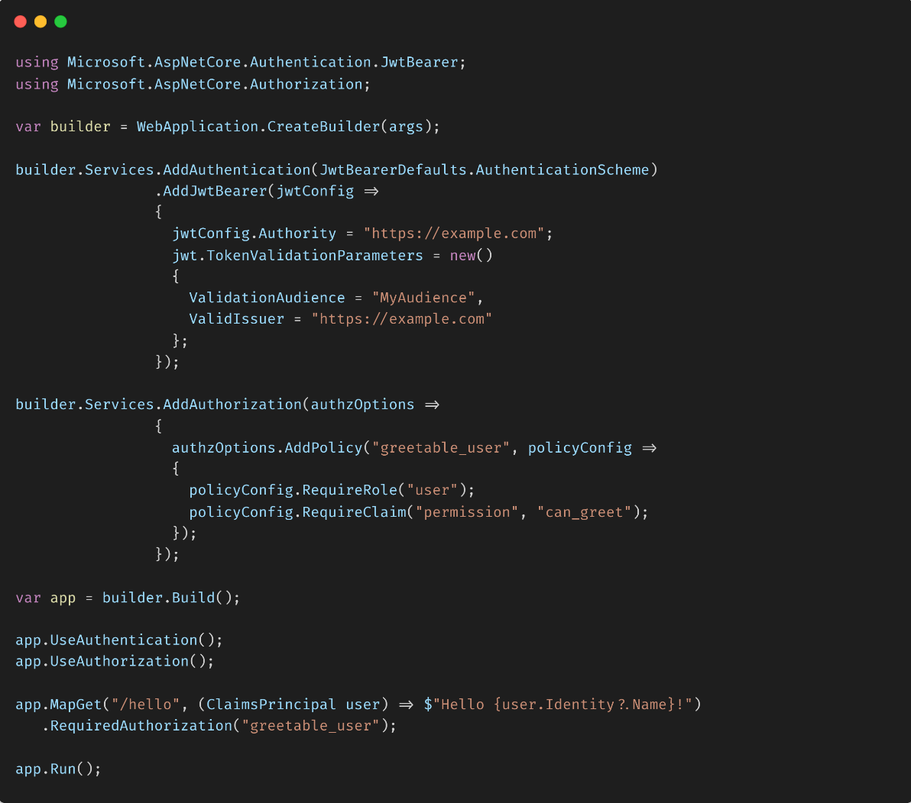
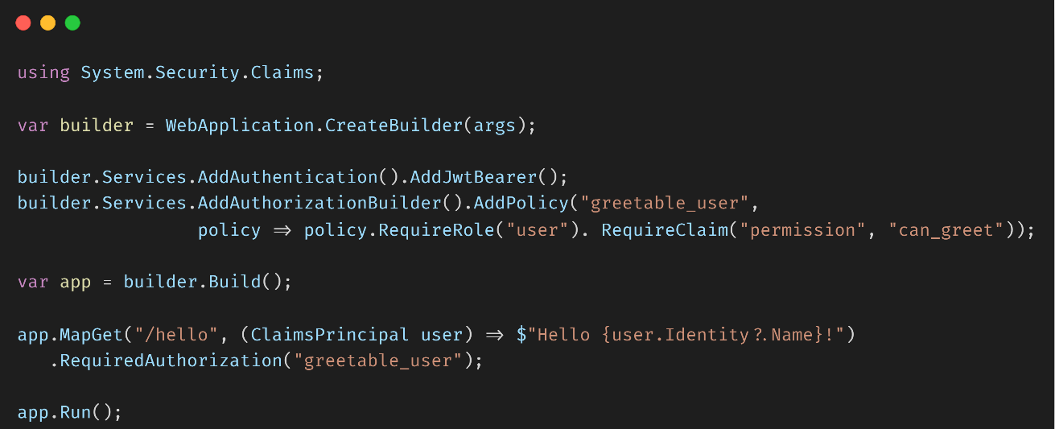
.NET REST APIs – Secure
.NET 6
.NET 7

Slide 22
REST APIs with .NET 7
Safia & Julia

Slide 23
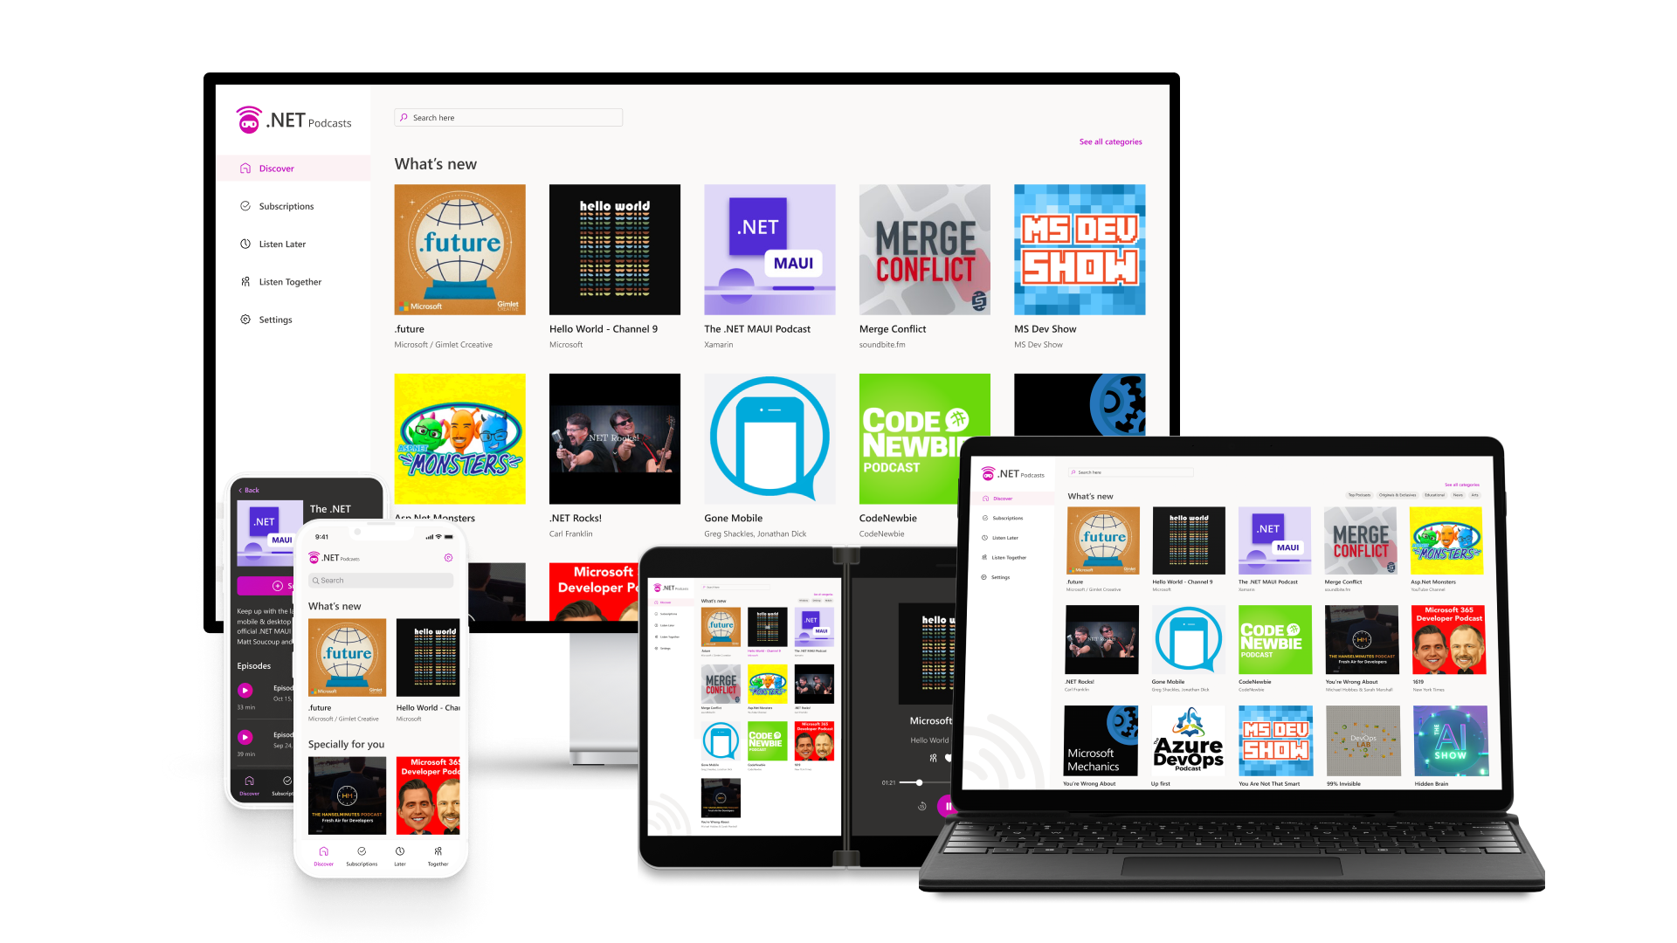
github.com/microsoft/dotnet-podcasts

Slide 24


APIs are everywhere
.NET
APIs

Slide 25


Dev Tunnels in Visual Studio
LOCAL ENDPOINT
PUBLIC ENDPOINT
YOUR TEAM
DEV TUNNEL
https://localhost:5000/...
https://myapp-5000.devtunnels.ms/...
Learn more
|
aka.ms/devtunnels/vs

Slide 26
Easy to upgrade

Slide 27
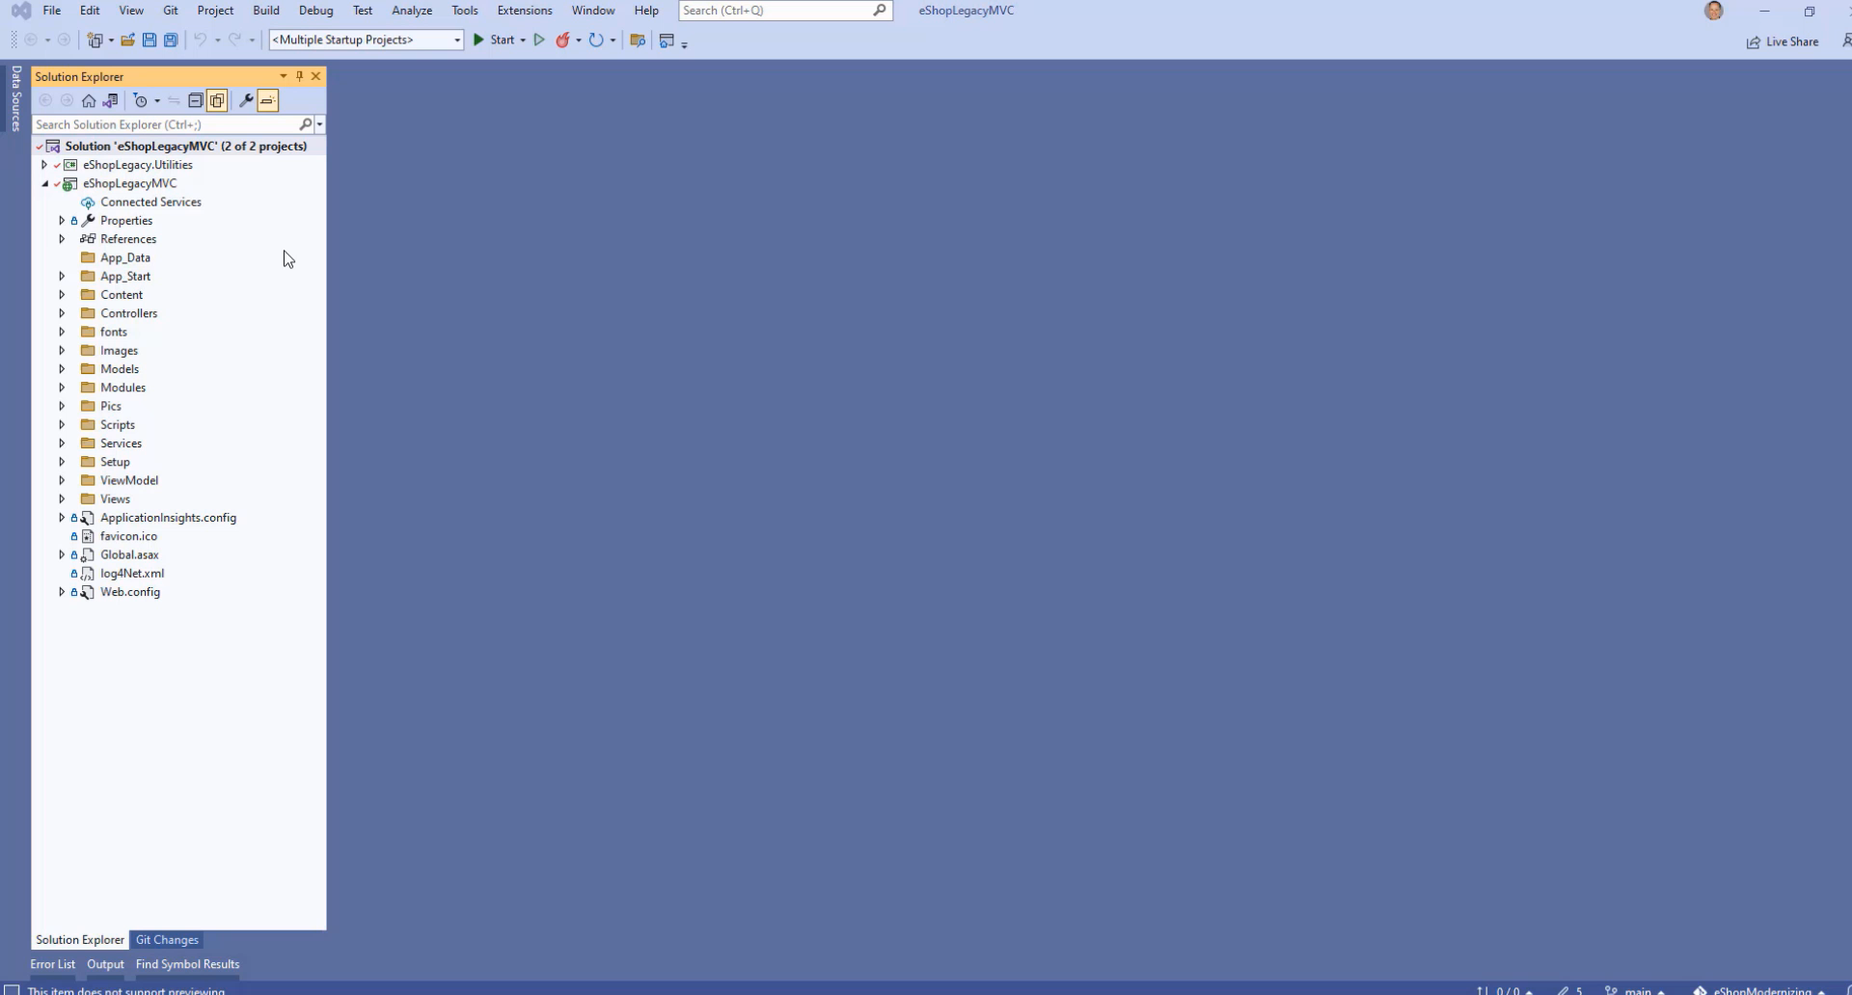
Incremental ASP.NET Upgrades
Preview

Slide 28
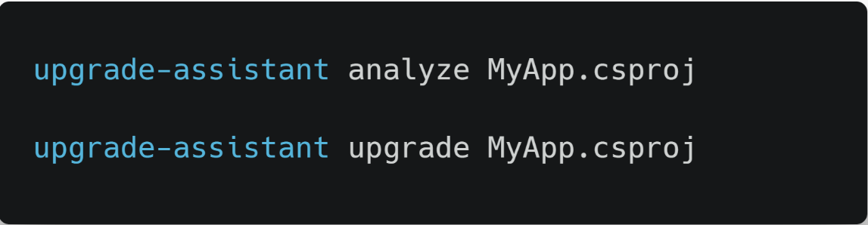
.NET Upgrade Assistant
New in .NET 7
More analyzers and code fixers
Ability to analyze binaries
UWP to Windows App SDK
Preview: Xamarin to .NET 7 & .NET MAUI
178K+
>4x
DOWNLOADS
YoY INCREASE
aka.ms/dotnet-upgrade-assistant

Slide 29









.NET APIs power Microsoft at scale
Azure Active Directory
Microsoft Graph
Azure
Cosmos DB
aka.ms/dotnet-developer-stories

Slide 30
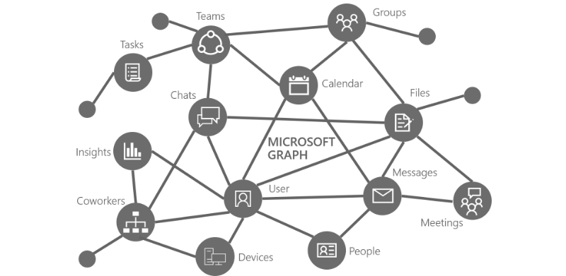
Microsoft Graph
>70 billion
70x
-91%
API REQUESTS PER DAY
SCALE OVER 4 YEARS
COST DECREASE OVER 4 YEARS
2019
2020
2021
2022
.NET Framework 4.75
IIS with ASP.NET
.NET Core 3.1
Kestrel with ASP.NET Core
.NET 5
HTTP.sys with ASP.NET Core
.NET 6
HTTP.sys with ASP.NET Core
Full Story: https://aka.ms/msgraph-upgrade

Slide 31

Geocaching HQ
"Geocaching is the world’s biggest game of hide-and-seek."
"We grew from thousands to millions of customers - we had to learn to scale fast."
"Our entire backend is built on .NET APIs, which help us scale across the globe."
100M+
1B+
API calls per day
Geocache logs
-Sean Boots, Director of Engineering, Geocaching HQ

Slide 32
Cloud Native with .NET

Slide 33
The app of the future is Cloud Native
50%
Scale to meet any demand
Achieve greater resiliency
Deliver better apps faster
OF ORGANIZATIONS WILL USE CLOUD-NATIVE TECHNOLOGIES BY
2024
IDC FutureScape

Slide 34
Cloud Native Developers
60%
41%
66%
Backend Developers use Containers
Backend Developers Identify as Cloud Native Developers
Cloud Native Developers work on Microservices in last 12 months
SlashData

Slide 35
Canonical + Microsoft

Slide 36
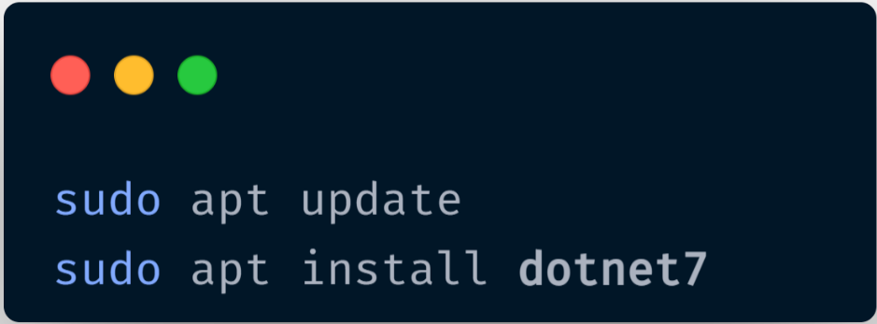
.NET in Ubuntu
.NET is in-box
Built by Canonical; help from Microsoft
Canonical enterprise-grade support
Same day updates for patches
x64 and Arm64 with .NET 6
.NET 7 coming soon

Slide 37
.NET in Ubuntu
.NET in Chiseled Ubuntu containers
Distroless images == Bare minimum
Quicker to pull/start​
More secure – no shell
More secure – no package manager
More secure – non-root user
ASP.NET Core on Ubuntu
MB
-52%
MB

Slide 38
.NET apps on ARM64
Tech Empower JSON
Performance on par with x64
Native support for Visual Studio
Native support for .NET Framework 4.8.1
.NET performs on your hardware choices

Slide 39
.NET SDK Containers

Slide 40




.NET SDK Containers
dotnet publish -r linux-x64 /t:PublishContainer –c Release
aka.ms/dotnet/containers/customization

Slide 41
.NET Containers
David & Chet

Slide 42



























Building cloud-native on Azure
Community
Security
AI
Azure Active Directory
Azure Policy
Microsoft Defender
Cognitive Services
Applied AI
Machine Learning
Development tools
Containers and serverless
Managed databases
Storage
GitHub
Azure Kubernetes Service
Azure Container Apps
Azure Functions
Azure PostgreSQL
Azure Cosmos DB
Azure SQL family
Azure MySQL & MariaDB
Azure Storage
Visual Studio Code
Azure API Management
Azure Container Registry
Cloud operations anywhere
Azure Arc

Slide 43

Building cloud-native on Azure
Community
Security
AI
Azure Active Directory
Azure Policy
Microsoft Defender
Cognitive Services
Applied AI
Machine Learning
Development tools
Containers and serverless
Managed databases
Storage
GitHub
Azure Kubernetes Service
Azure Container Apps
Azure App Service
Azure PostgreSQL
Azure Cosmos DB
Azure SQL family
Azure MySQL & MariaDB
Azure Storage
Visual Studio Code
Azure API Management
Azure Container Registry
Cloud operations anywhere
Azure Arc

Slide 44
Modern Client with .NET

Slide 45


.NET Multi-platform App UI (MAUI)
Generally available
Unified .NET
Single project system, single codebase
Mobile, desktop, hybrid
WinUI
Mac
Catalyst
iOS
Android
Productive development
Native APIs, Native performance
macOS
iOS
Learn more
|
State of .NET MAUI – 11:00 AM Pacific

Slide 46
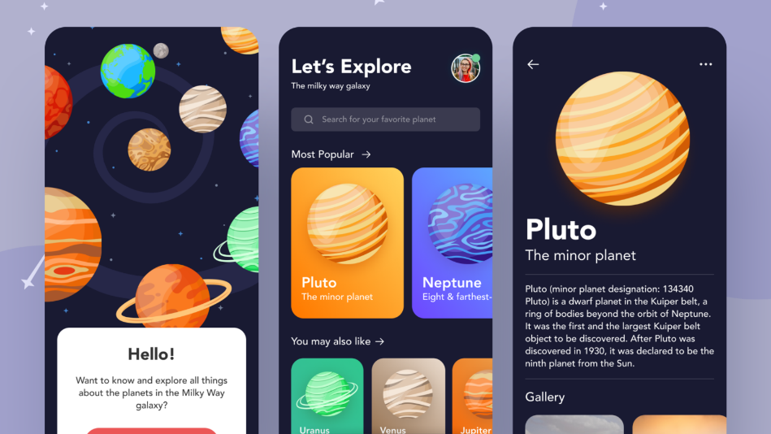

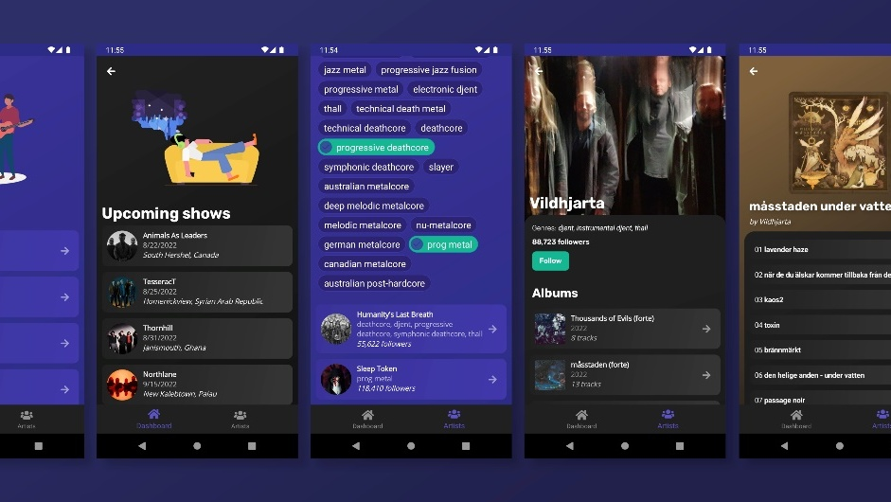
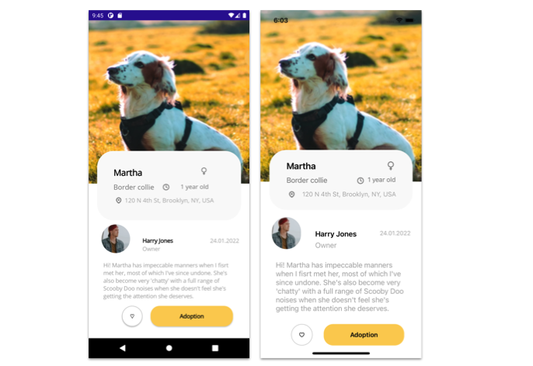
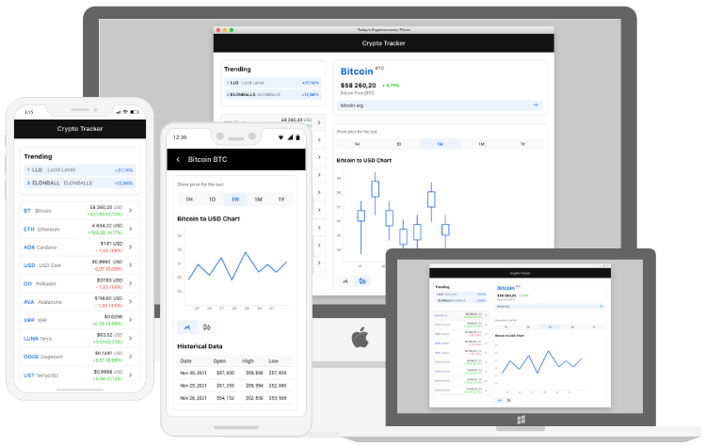
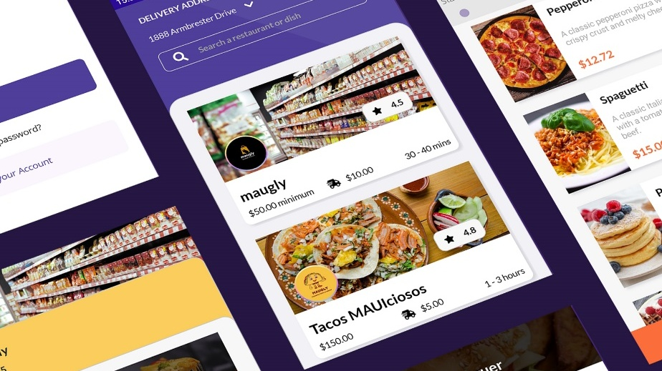
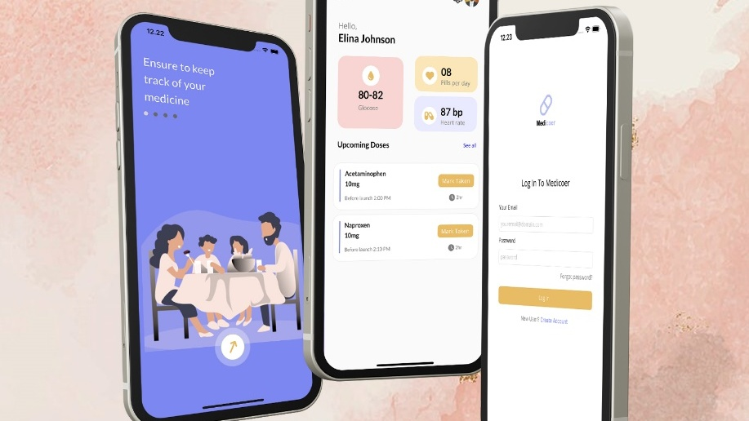
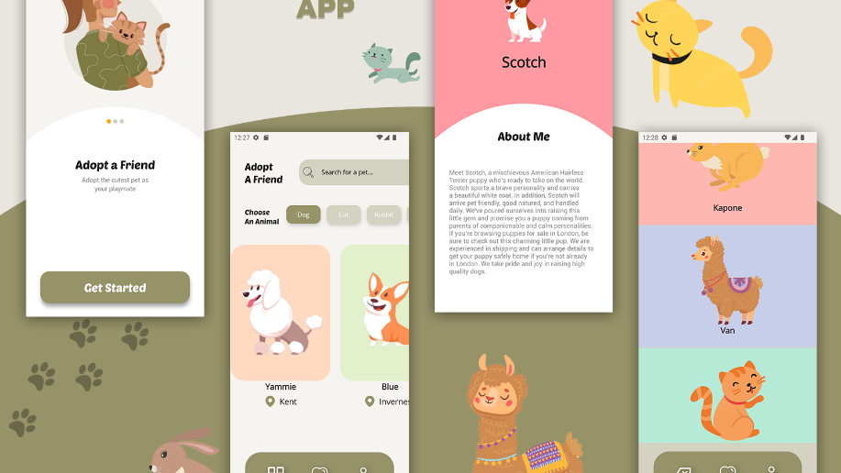
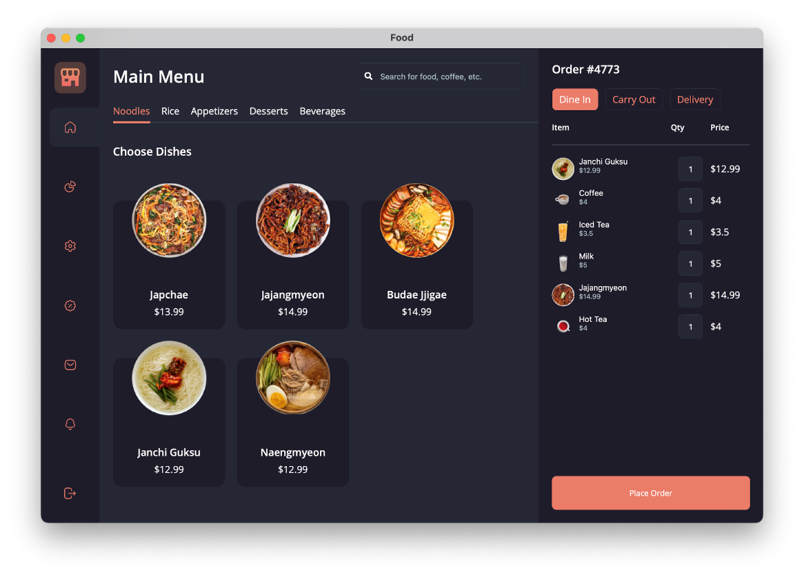
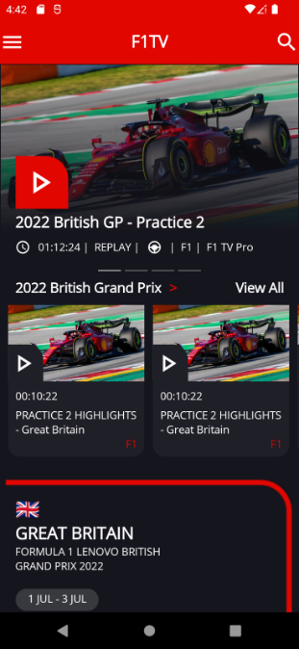
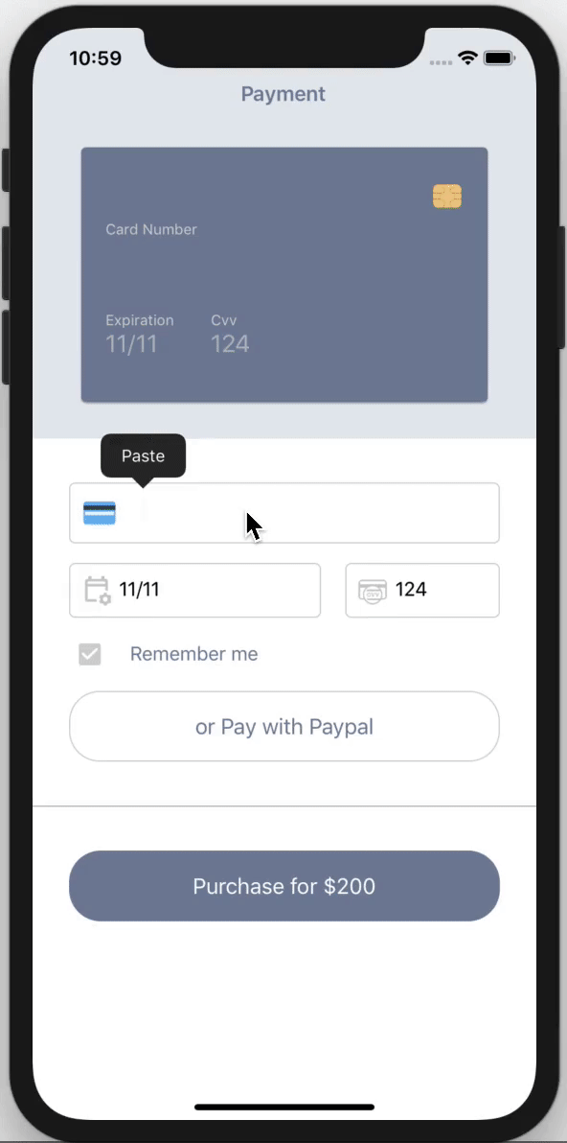
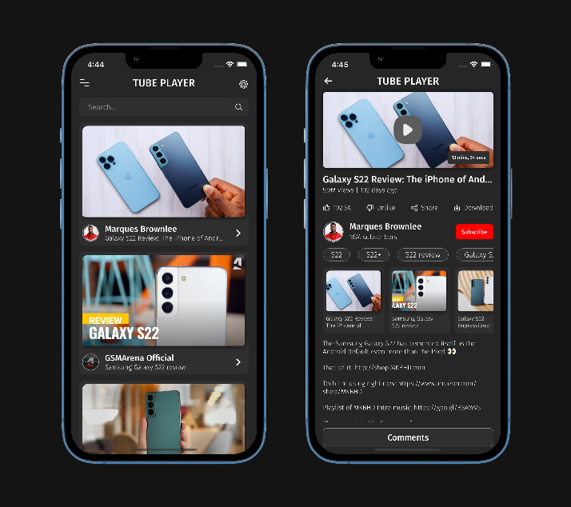
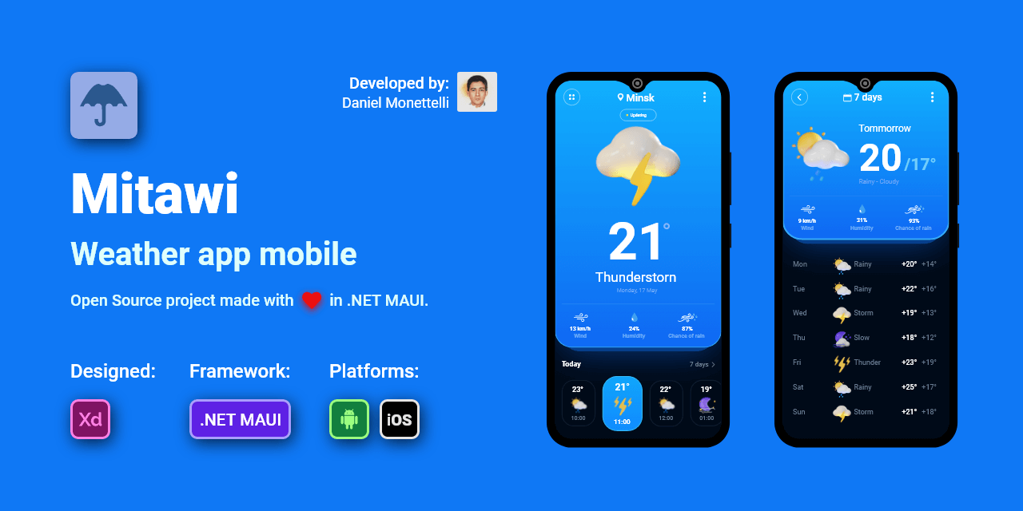
aka.ms/dotnetmaui/showcase

Slide 47
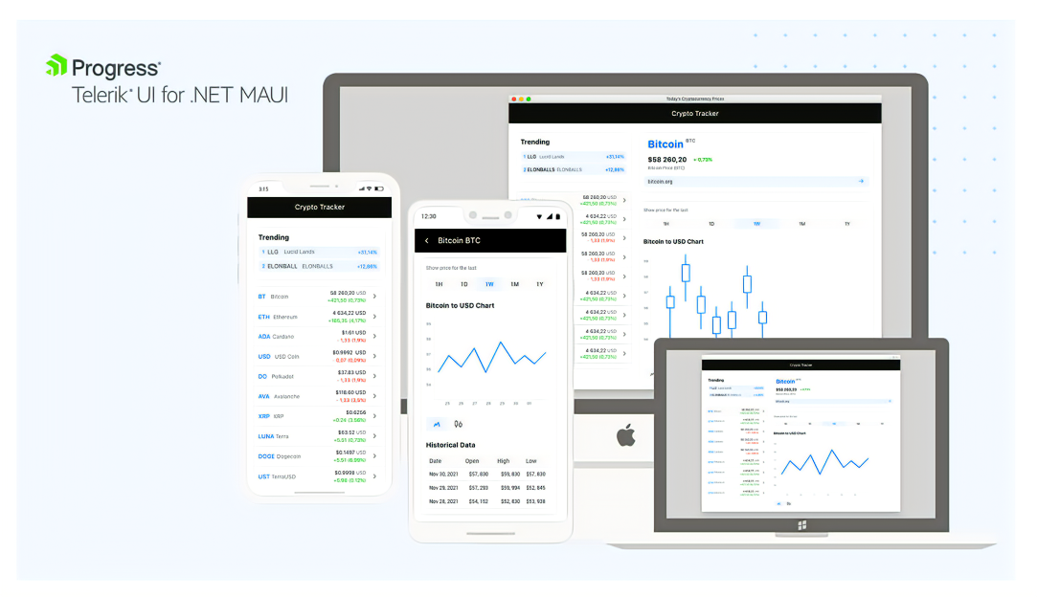
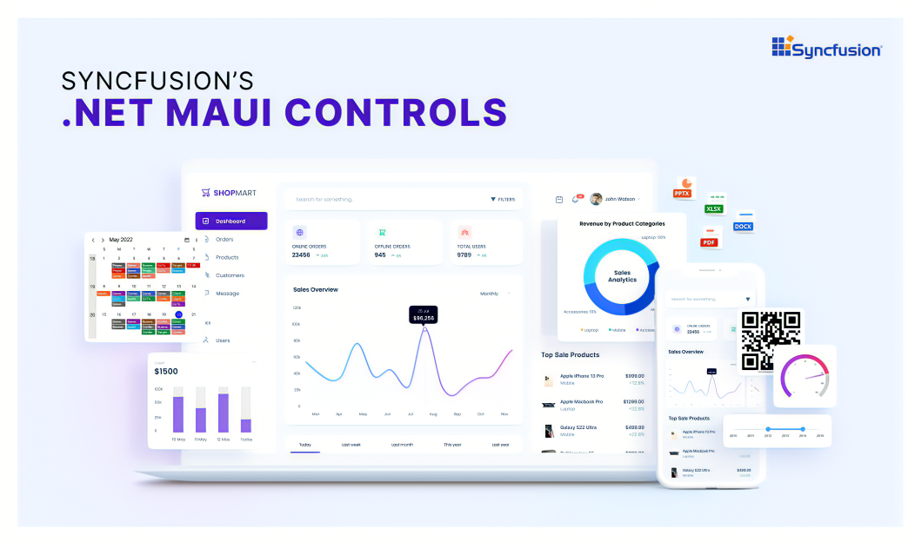


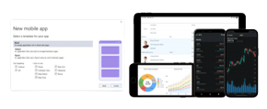
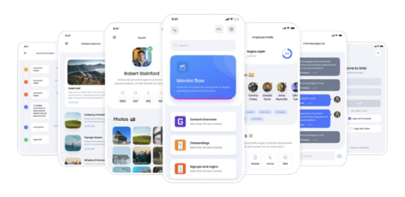





Ecosystem
Adoption

Slide 48



.NET offers choice for developers
BLAZOR
BLAZOR + .NET MAUI
.NET MAUI
C#, HTML, CSS
C#, XAML
Reach
Depth
Websites and PWAs
Hybrid
Native

Slide 49

Tune in to State of the Platforms:
ASP.NET Core
Azure + .NET
.NET MAUI
State of ASP.NET Core
State of Azure + .NET
State of .NET MAUI
9:00 AM Pacific
11:00 AM Pacific
1:00 PM Pacific

Slide 50

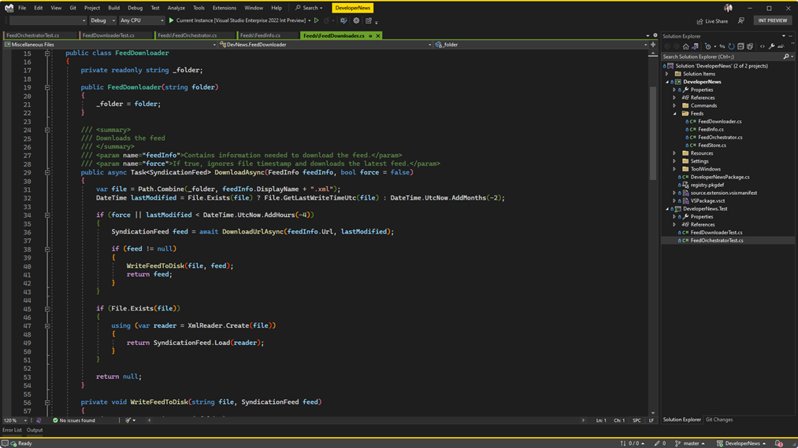
Visual Studio 2022 v17.4
RELEASED
Modern development for .NET 7 using WSL2
Code faster than ever before with Hot Reload
64-bit Performance, scale for any size project
visualstudio.com/download

Slide 51
Thank You!
Let's build amazing apps with .NET 7 get.dot.net/7

